Slide 1
WIT HACKATHON
TechDivas presents:
BiteSavr
By Ella Smith,
Aditi Khedkar,
Bhakthi Salimath
Your smart shopping company

Slide 2
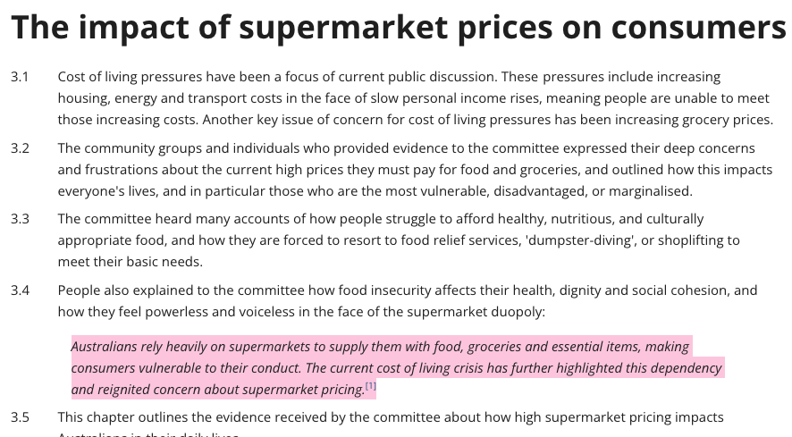

The Problem
Many consumers struggle to find the best prices across multiple grocery stores.
Time-consuming price comparisons
Uncertainty about where to shop for the best deals
Frustration of overspending on groceries
[1] Fair Food WA and WA Council of Social Service, Submission 6, p. 2 .
Notes:
Aditi
How many times have you been in Aldi but wondered if that item was cheaper at Coles… we all know that as students, every dollar counts, and finding the best prices can make a huge difference."
Our bank accounts and Fair food WA tell us inflation is real, and the cost of living crisis further affects all of our bills and teh fluctuating costs of supermarkets make it difficult to know if you’re getting the best bang for your buck.

Slide 3
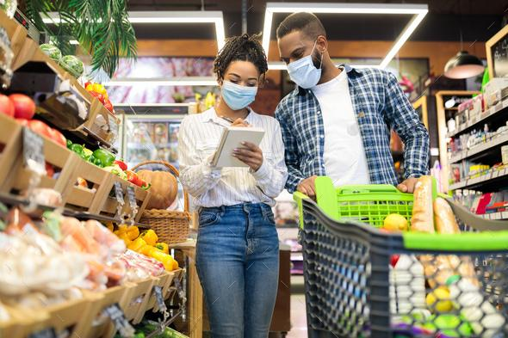
Target Audience
Busy families
Students
Budget-conscious shoppers
Intention:
Saves time and money
Simplifies the shopping experience
Offers transparency in pricing
Notes:
Bhakthi
grocery shopping can be stressful, especially for those juggling a million things—whether you’re a busy parent, a student on a tight budget, or just someone trying to save where you can especially in this economy. This is where biteSaver comes in. Our application is designed for busy student who don’t have time to compare prices at multiple stores and are living on a shoestring budget, and for anyone looking to maximize their savings.

Slide 4
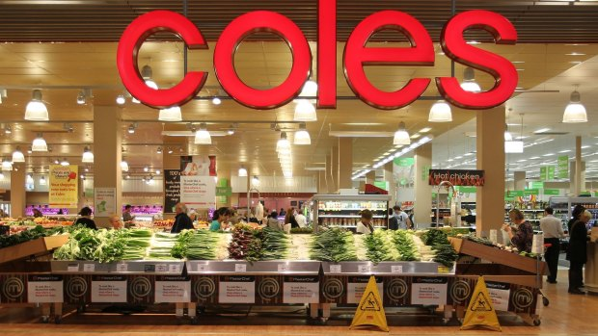
Qualities of Our App
User-Friendly Interface: Intuitive design for easy navigation
Personalized Shopping Lists: Input your list and let BiteSavr do the work.
Price Comparison: Real-time price checking across Coles, Aldi, and Woolworths.
Notes:
Our web app features a userfriendly interface that guides each user into being able to correctly input and understand the best place for their groceries! We have a toggle feature that allows them to switch between displays which rep different forms of the shopping list that the user may desire, Additionally, our app creates personalized shopping lists and implements real time price checking for accurate efficient usage.

Slide 5
Our Solution
How it Works
Users input their shopping list.
BiteSavr retrieves current prices from selected stores.
Provides a list of the cheapest options across different stores or if you only want to shop at 1.
*We’ll walk through a hypothetical scenario of a user finding the best prices for their list*
Notes:
Ella

Slide 6
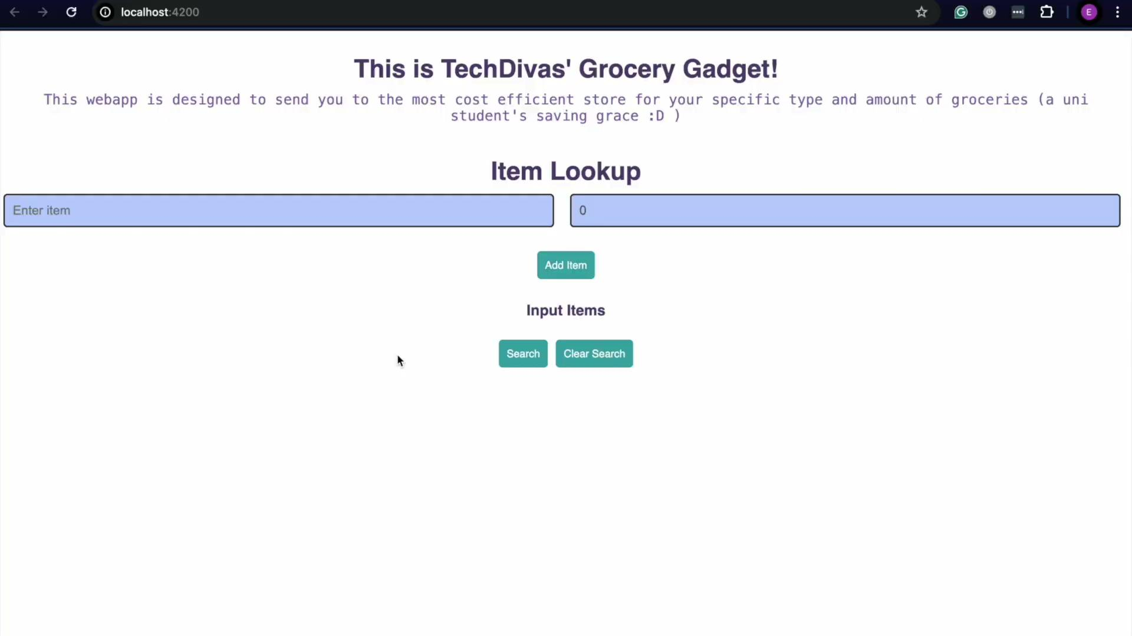
Our Demo

Slide 7

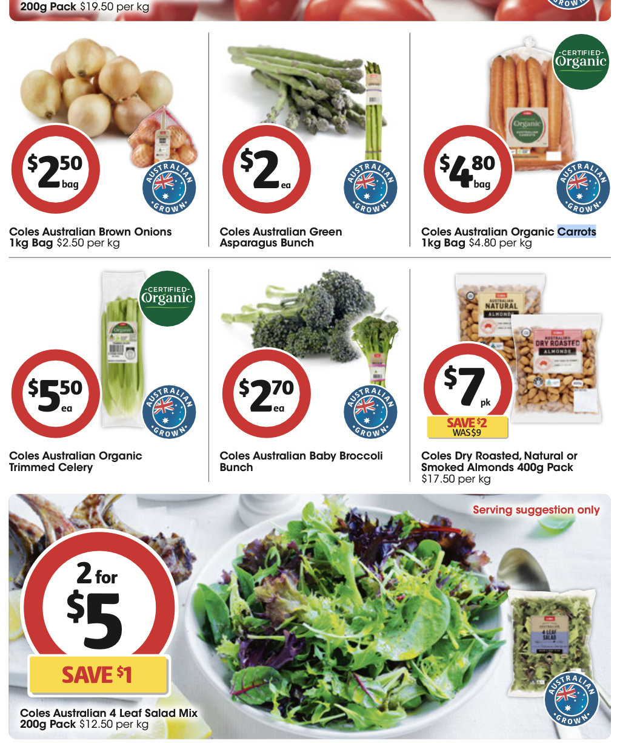

Slide 8
Our Demo

Slide 9

Solution Diagram
Our Wireframe!
This image details the frontend ui and its connection to our backend work
The backend section shows comparing between the databases to find the lowest aggregated cost

Slide 10
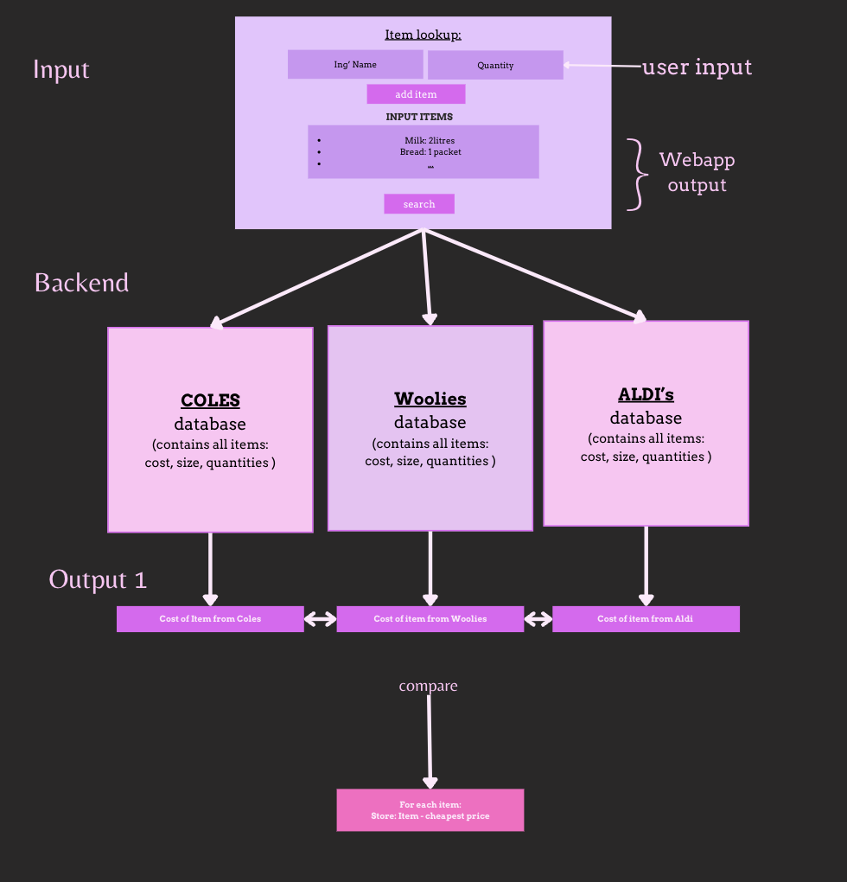

Slide 11
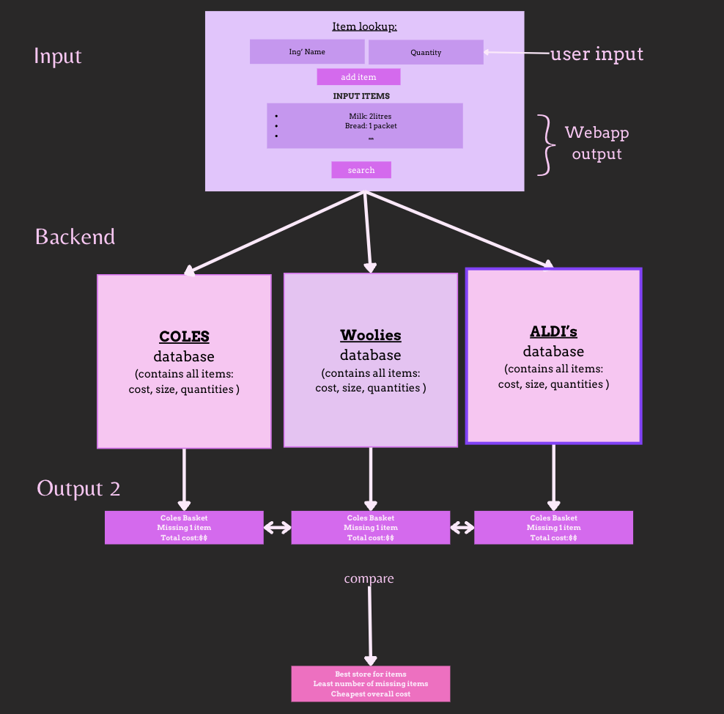

Slide 12
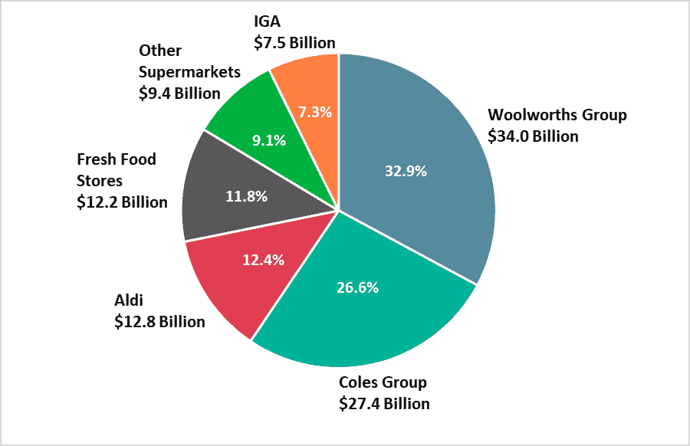
Future implementation
Features:
Expanding to include more stores and online options.
Automatically download PDFs of the stores weekly specials & catalogue.
Adding recipe suggestions based on shopping lists.
Partner with stores to gain access to APIs and
web scraping capacities
Vision:
Become the go-to app for grocery shopping,
helping users save money and time.
[2] (Top 10 Supermarkets in Australia - Shop Smarter, 2022) .
Notes:
Bhakthi
Now looking at future implementations, BiteSavr is all about expanding and enhancing the user experience.
expand our store coverage to include more supermarkets and even online options, allowing users to compare prices from a wider range of retailers.
we’re working on is the ability for users to automatically download PDFs of weekly specials and store catalogues
also were developing a feature that offers recipe suggestions based on your shopping list. Imagine getting meal ideas that match the items you’re already planning to buy, helping you save even more time and money in the kitchen.
were also planning to partner with stores to gain access to their APIs and enhance our web scraping capabilities to ensure that our price comparisons are always up-to-date and accurate. providing even more products.
Now our vision with

Slide 13
Q & A
BiteSavr
Please feel free to ask us questions about our project!
Notes:
Everyone

Slide 14
BiteSavr
Thank you!
Xoxo,
★ TechDivas ★

Slide 15
References
[1] - Top 10 Supermarkets in Australia - Shop Smarter. (2022, October 5). RedSheep. https://www.trolleymfg.com/supermarkets-in-australia/
[2] - The impact of supermarket prices on consumers. (2020). Aph.gov.au. https://www.aph.gov.au/Parliamentary_Business/Committees/Senate/Supermarket_Prices/SupermarketPrices/Report/Chapter_3_-_The_impact_of_supermarket_prices_on_consumers
Notes:
??

